Slide 1

HEALTH CARE MANAGEMENT SYSTEM FOR DOCTORS
TEAM - 1
An application portal for doctor to access their patient’s health diagnosis.
18K41A0505 – AREEFA ----
18K41A0527 – K. HARSHITH
18K41A0528 – K. PRAGATHI
18K41A0529 – K. RISHITHA

Slide 2
CONTENTS
MAIN OBJECTIVE OF THE PROJECT
OBJECTIVES - STRATEGIES
ELEMENTS USED
SCREENS
TEST CASES AND RESULTS
MODULE 1- STAFF (New Patient Register)
MODULE 2 - DOCTOR ACCESS
CONCLUSION

Slide 3
Abstract
In many hospitals where patient’s approach for routine course for their treatment of their health issue face problem in maintaining all the reports and doctor prescription. At every appointment they need to carry their health book or repeat detailing about their issue to doctor.
What if the doctor maintains the patient’s health issue diagnosis?
A feasible application that would help doctor to manage his/her patient’s health care diagnosis data.

Slide 4
Main Objective of the Project
The main aim of this project is to design an effective application portal for ensuring health care The main aim of this project is to design an effective application portal for ensuring health care management strategies in a clinic where the patients' health issues and the records of the treatment can be maintained so that a proper improvement in health can be assessed easily for the doctors and the patient need not to detail about his/her health issue to the doctor every time specifically.

Slide 5
Objectives
The health care management portal must include the modules for both the doctor and the staff by supporting the following strategies:
Allow New patients to register by selecting the doctors from the doctors available list.
Doctors to be able to view the patients' list.
Easy access for a doctor to get his/ her patient’s health issue history and about the previous appointment prescription by him/her by their ID.
Display of particular patient profile based on their Id such that no need for the patient to explain about his/her health issue again and again.
The patient’s profile must be editable only by the doctor.
For the next appointment, the profile will be updatable (To add any other health issues or medicines)
The patient to be guided about his health care and diet.
The printed diet prescription avoids the conflict by doctor’s hand-writing.

Slide 6
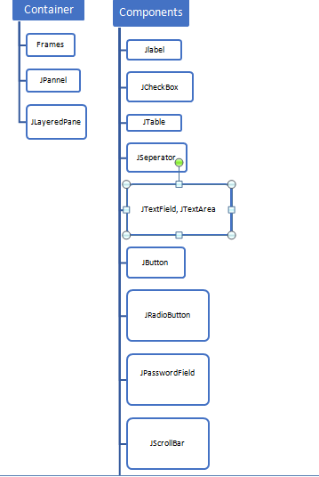
Elements Used
We used the Eclipse IDE to build this application. In which we approached the Window Builder to design our screens involved relatively including the elements and Swing concepts. Files are the medium that we used in storing the data and retrieving the data respectively in an efficient way.
SWINGS: It is used to create a window-based application and is built on the top of AWT (Abstract Windowing Toolkit) API (Application Programming Interface) and is entirely written in java.

Slide 7
Application – pages or windows: Software used: eclipse IDE (java project)
Doctor Login
Recognizing Doctor – Image (A Welcome window)
Patient Login
Whole Patient List window
Patient diet
Patient profile (corresponding)
Patient details – Age , BP, weight
Patient health issue
Patient previous medical prescription
Additional reports data (needed if any)
Diet ---------- window
Patient diet

Slide 8
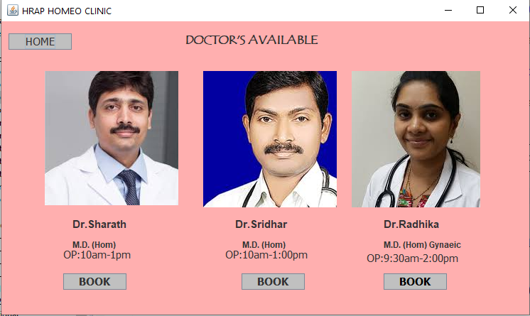
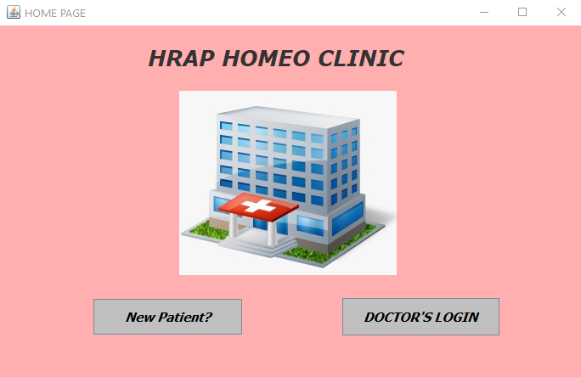
Screens

Slide 9
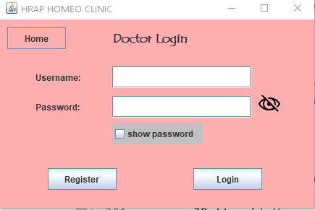
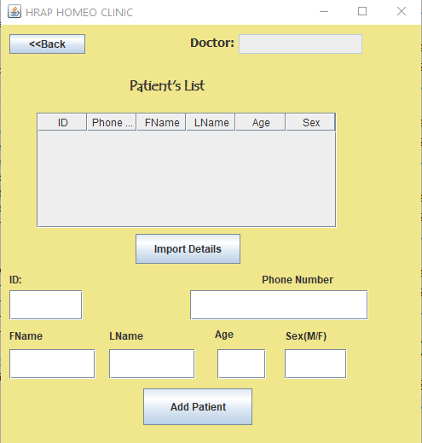
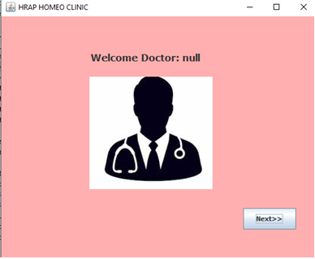
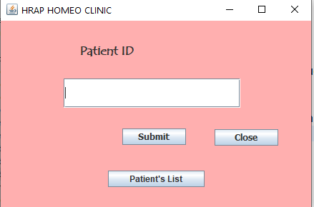

Slide 10
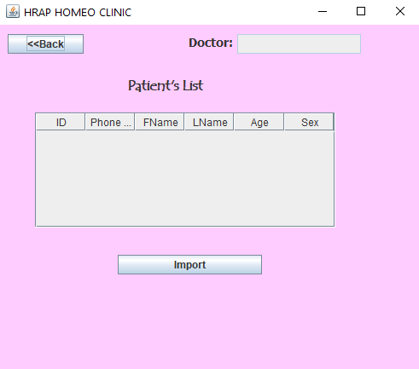
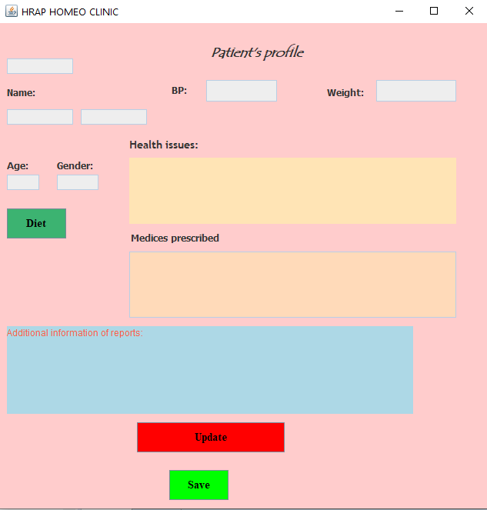

Slide 11
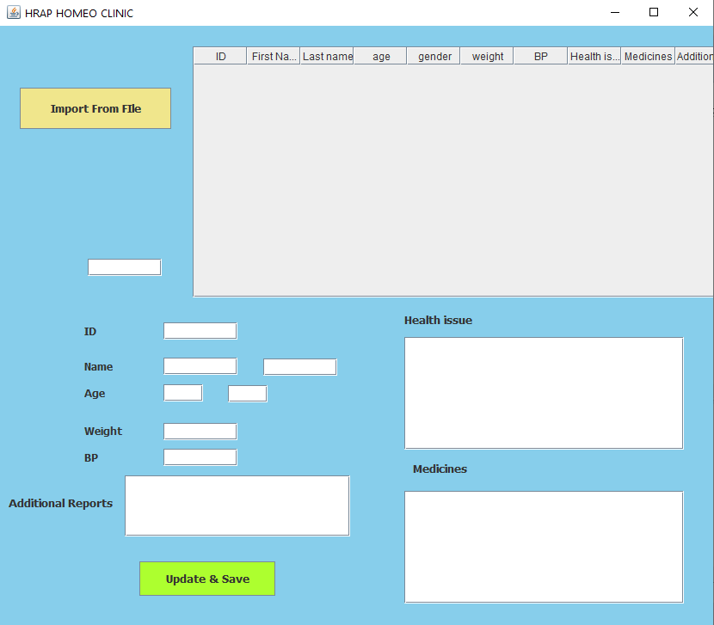
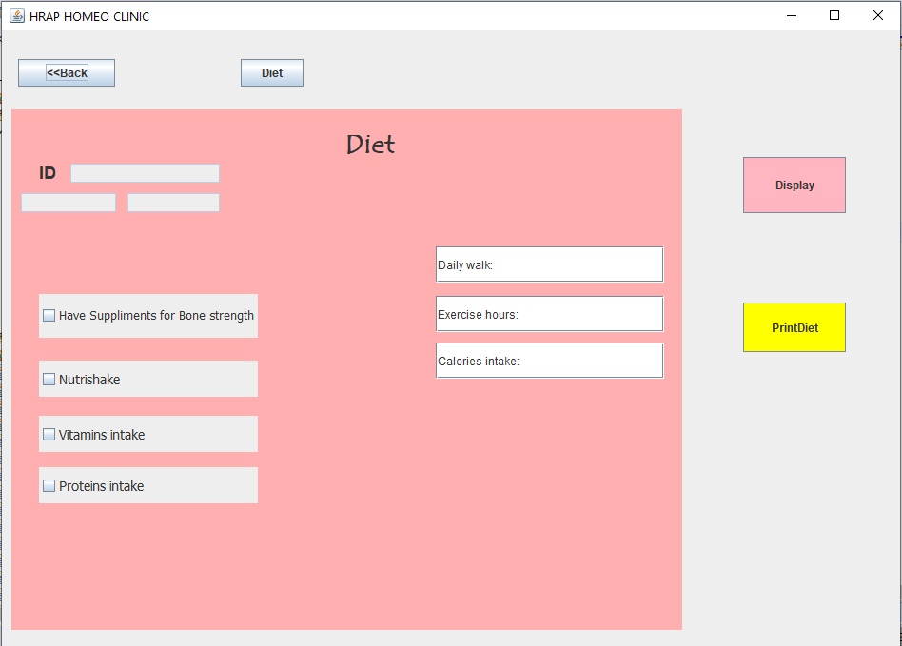

Slide 12
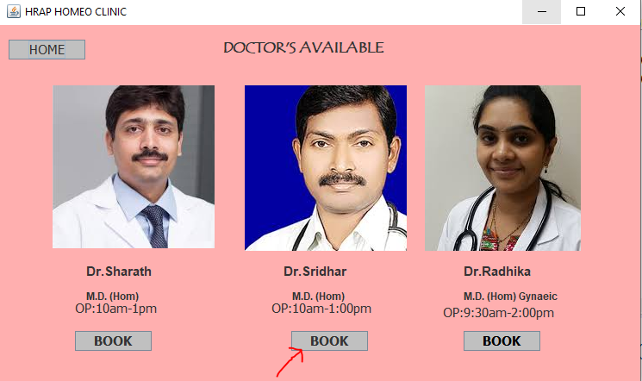
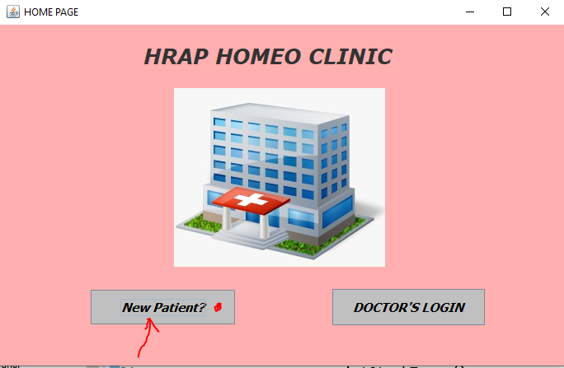
Test Cases and Test Results Module 1: If new Patient (Register- Staff)

Slide 13
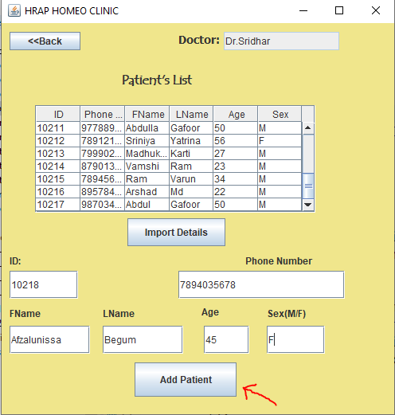
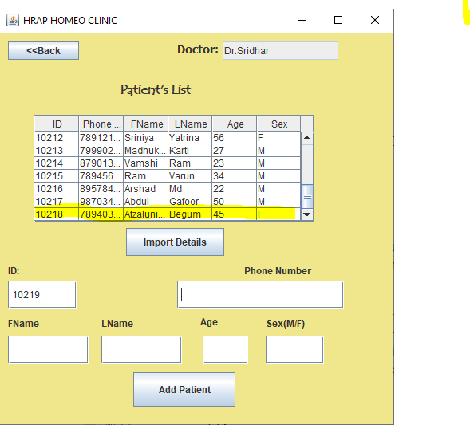
Patient Added

Slide 14
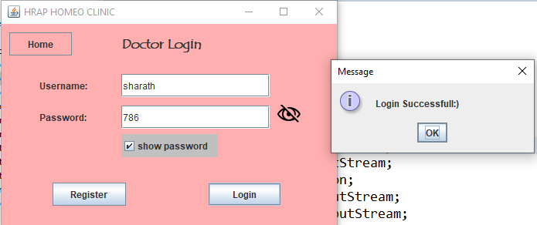
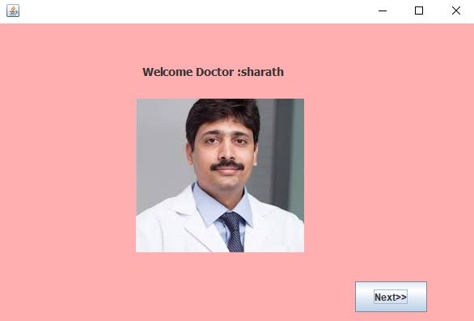
Module 2- Doctor Access

Slide 15
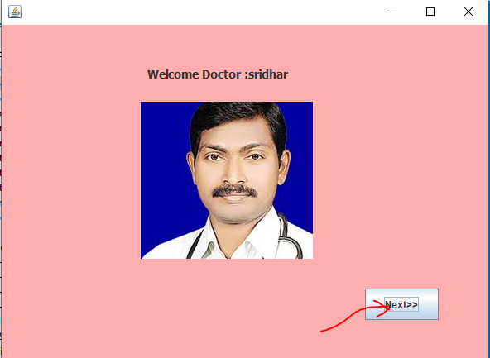
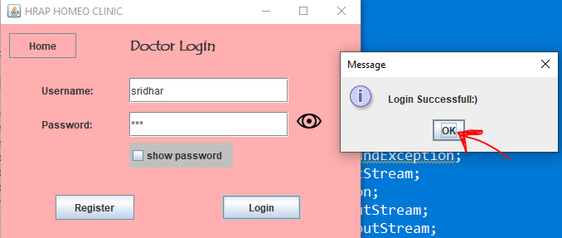
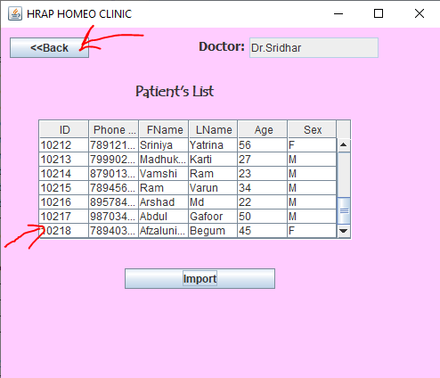
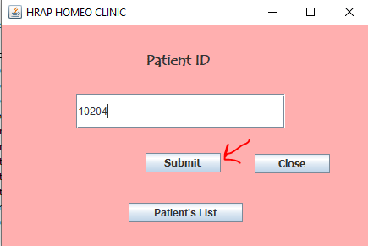
Another doctor

Slide 16

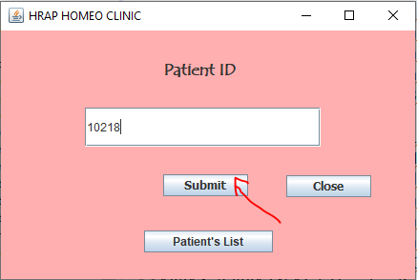
New patient profile – Null values initially

Slide 17
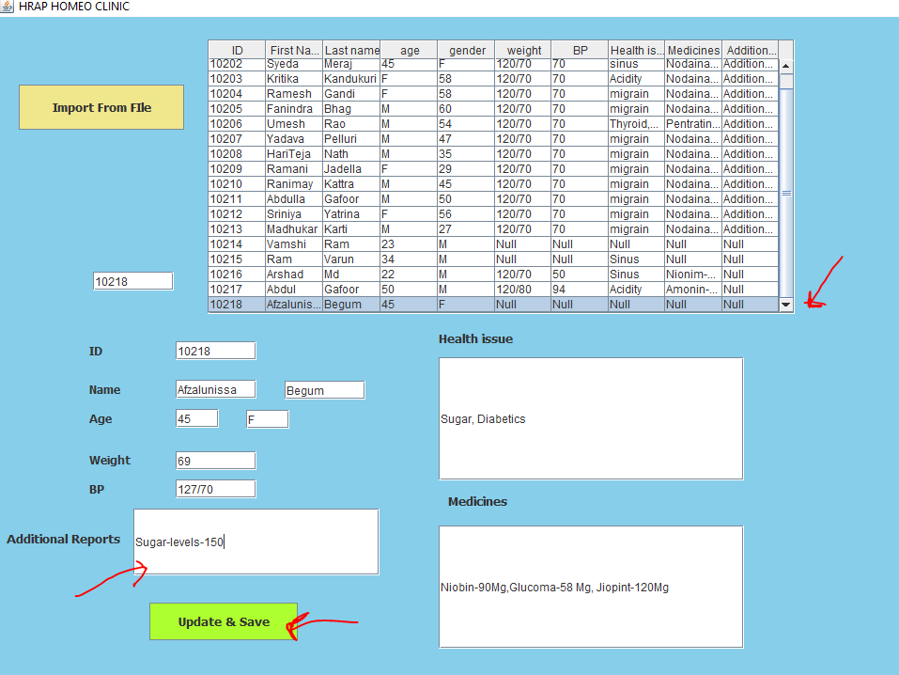
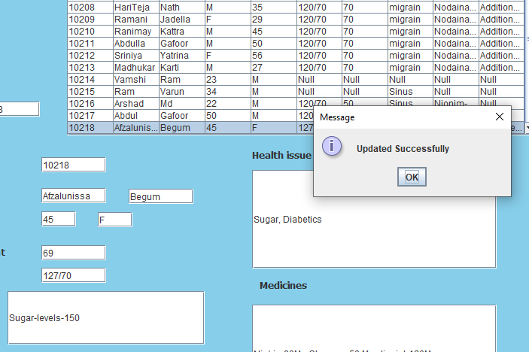
Updating the profile

Slide 18
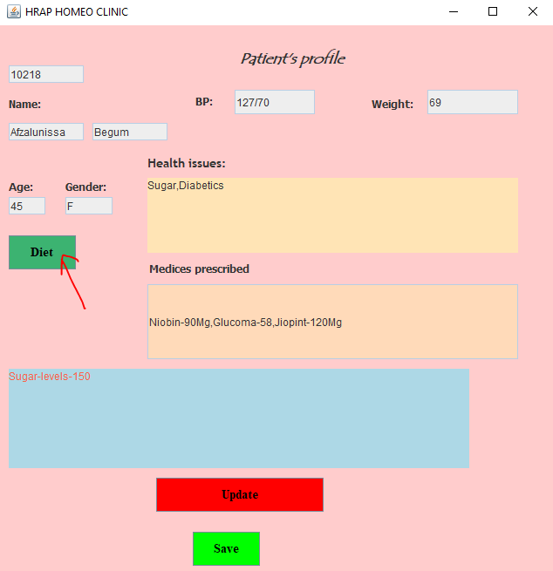
Updated:

Slide 19
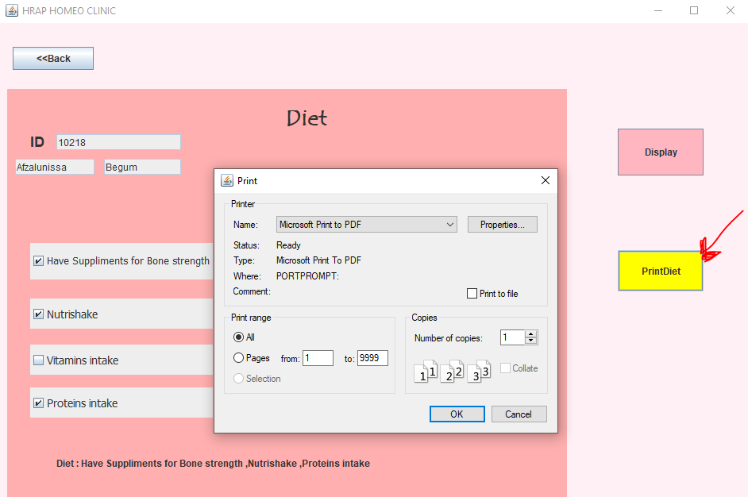
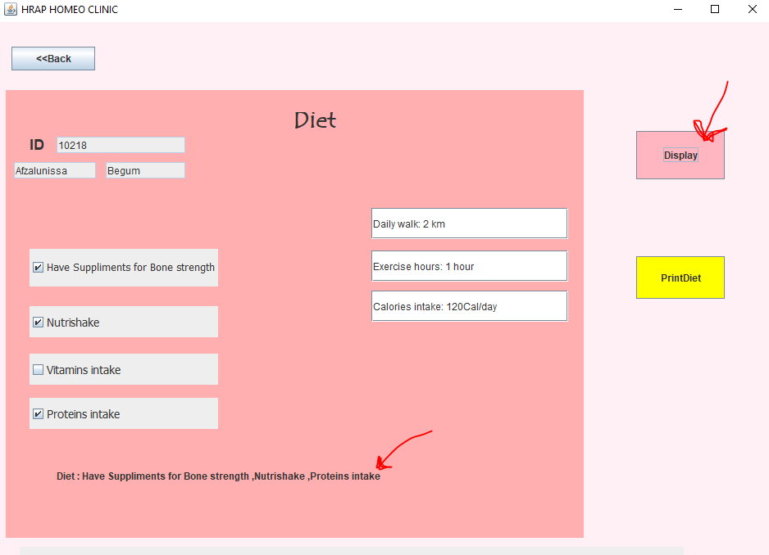
Diet – Save and Export to printer

Slide 20
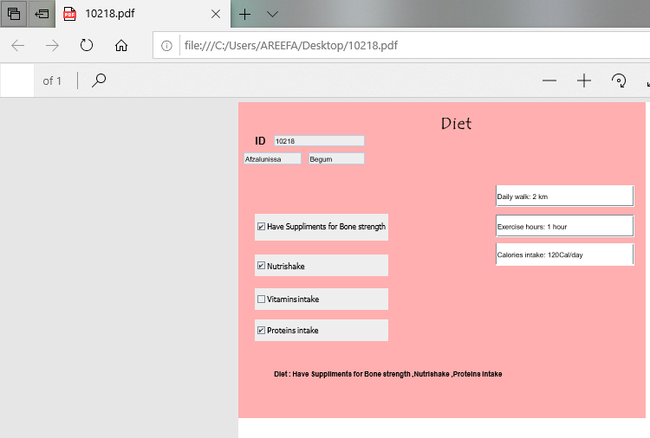
Pdf – diet printed

Slide 21
Conclusion:
The Health Care Management Portal for doctors is helpful to maintain the patient’s records and integrates both the doctor and the patient without any conflicts.
By this, patient need not to carry the previous appointment prescriptions or reports and patient need not to detail about health issue again. Thus, there is no need of even writing the prescription onto the receipt by the doctor and this even avoids the conflicts by the doctor’s messy hand writing since, diet plan prescription would be given printed.
Thus, one java application can lead to solving the concerns between the patient and the doctor. At last, we would conclude that, health care management plays a major role in producing a happy outcome after a particular treatment and thus, health care management portal for doctors helps in implementing the above strategies.

Slide 22


